Slide 1
Testing of Digital Circuits

Slide 2
Design Approaches
Test pattern generation to cover a large fraction of the faults
Design for testability
  Built-in-self-test (BIST)
Fault tolerant design

Slide 3
Faults: Sources and Types
Sources
  Design process
  Device defects
  Manufacturing process
Types
  Dynamic
  Static

Slide 4
Fault Models
Stuck-at faults correspond to a simple fault model
  Stuck-at-0 (s-a-0)
  Stuck-at-1 (s-a-1)
More complex models are also used but beyond the scope of this work

Slide 5
Combinational Circuits: Test Pattern Generation
Problem definition:
Given a set of faults (F) and a set of test vectors (T), identify the smallest possible subset of test vectors (V) which covers either all the faults in F or say a predetermined fraction of faults (say 98%).

Slide 6
Fault Simulation
Given a test vector, by simulating the circuit with the fault, identify all faults covered by the test vector.
Test
vectors (T)
Faults (F)

Slide 7
Test Generation
Given a fault, identify all the test vectors which can cover that fault.
Test
vectors (T)
Faults (F)

Slide 8
Limitations
Only one fault is expected to occur at one time
Faults other than stuck-at faults are expected to show up as stuck-at faults at some other location
By and large fault location is not possible
These approaches are valid only for combinational circuits

Slide 9
Typical Circuit Enhancements
Insertion of test points
Pin amplification
Test modes
Scan chains

Slide 10
Test Generation Methods

Slide 11
Parallel Fault Simulation
In parallel fault simulation, evaluation is performed simultaneously for many faults
The number of faults that can be simultaneously simulated corresponds the word length of the host machine

Slide 12
Parallel Fault Simulation (Example)
a
i
b
f
c
h
d
g
e

Slide 13
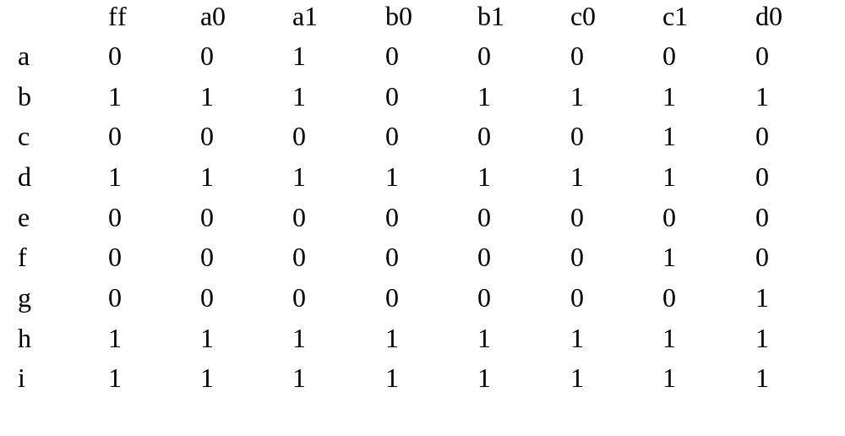
Parallel Fault Simulation
(Example contd.)

Slide 14
Deductive Fault Simulation
At each of the primary inputs generate the list of faults that can be detected by the test vector
Use these lists to generate the lists at other nodes by “appropriate” operations on these lists

Slide 15
Deductive Fault Simulation (example)
La = {a1} Lb = {b0} Lc = {c1} Ld = {d0} Le = {e1}
a
0
1
i
b
1
f
c
0
Lfp = Lb’ ∩ Lc = {c1}
Lf = {c1, f1}
Lgp = (Ld’ ∪ Le)’ = {d0}
Lg = {d0, g1}
Lhp’ = (Lf ∩ Lg)’, Lhp = Φ
Lh = {h0}
Lip’ = La ∪ Lh’, Lip = {h0}
Li = {h0, i0}
0
h
1
d
1
0
g
0
e

Slide 16
Deductive Fault Simulation
(example contd.)
La = {a1} Lb = {b0} Lc = {c0} Ld = {d0} Le = {e1}
a
0
1
i
b
1
f
c
1
Lfp’ = Lb’ ∩ Lc’ = { b0, c0}
Lf = {b0, c0, f0}
Lgp = (Ld’ ∪ Le)’ = {d0}
Lg = {d0, g1}
Lhp’ = (Lf ‘∩ Lg)’
Lhp = {d0,g1} , Lh = {d0,g1,h0}
Lip’ = La ∪ Lh’, Lip = {d0, g1,h0}
Li = {d0, g1, h0, i0}
1
h
1
d
1
0
g
0
e

Slide 17
Test Generation Methods Boolean Difference & D-Algorithm
M. Balakrishnan
Dept. of Comp. Sci. & Engg.
I.I.T. Delhi

Slide 18
Boolean Difference
Consider a function f of say 4 variables
f(x0, x1, x2, x3)
Boolean difference of f w.r.t to x_{i} is defined as follows:
df/dx_{i} = f⏐_{xi=0} + f⏐_{xi=1}

Slide 19
Boolean Difference (example)
a
i
b
f
c
h
d
g
i = a + ((b.c). (d +e)’)’
e
di/da = i⏐_{a=0} + i⏐_{a=1}
= ((b.c).(d+e)’)’ + 1 = (b.c)(d+e)’

Slide 20
Example (contd.)
di/da = (b.c)(d+e)’
s-a-0 fault at a can be tested by
a.di/da = 1 or a.b.c(d+e)’ = 1
⇒ test vectors (1,1,1,0,0)
s-a-1 fault at a can be tested by
a’.di/da = 1 or a’.b.c(d+e)’ = 1
⇒ test vectors (0,1,1,0,0)

Slide 21
Boolean Difference (contd.)
a
b
f
c
h
d
g
i = a + (f. (d +e)’)’
e
di/df = i⏐_{f=0} + i⏐_{f=1} = 1 + (a +d+e)
= (a+d+e)’ = a’d’e’

Slide 22
Boolean Difference (contd.)
di/df = a’.d’.e’
s-a-0 fault at f can be tested by
f.di/df = 1 or fa’d’e’ = b.c.a’d’e’ =1
⇒ test vectors (0,1,1,0,0)
s-a-01fault at f can be tested by
f’.di/df = 1 or f’.a’d’e’ = (b.c)’.a’d’e’ = 1
⇒ test vectors (0,0,X,0,0) and (0, X,0,0,0)

Slide 23
D-Algorithm
There are three main steps in the D-Algorithm
Generate the fault
Propagate the fault to one of the outputs
(Forward or D-Drive)
Back propagate to get consistent assignment for inputs (Backward drive or back-propagation)

Slide 24
D-Algorithm (Step 1)
a
i
4
b
f
c
1
h
3
d
g
Let us say we choose
the fault g node s-a-0
e
2
Assign inputs to gate 2 to generate the fault
i.e. d = 0 and e = 0

Slide 25
D-Algorithm (Step 2)
a
i
4
b
f
c
1
h
3
0
D
d
g
Choose a path to the o/p
and propagate the fault
e
0
2
f is to be assigned 1 and a is to be assigned 0
to propagate D to the output i

Slide 26
D-Algorithm (Step 3)
a
0
D’
i
4
b
f
c
1
h
D’
1
3
0
D
d
g
Consistency Check
e
0
2
Assign inputs to gates (whose outputs have been
specified ) consistent with other assignments

Slide 27
D-Algorithm Result
a
0
D’
i
4
b
1
f
c
1
h
D’
1
1
3
0
D
d
g
e
0
2
The test vector is (0,1,1,0,0)

Slide 28
D-Algorithm
M. Balakrishnan
Dept. of Comp. Sci. & Engg.
I.I.T. Delhi

Slide 29
Terminology
Singular Cover
D-intersection
Primitive D-cube of a fault (pdcf)
Propagation D-cubes (pdf)

Slide 30
Singular Cover
SC of a gate (or any circuit element) is nothing but a compact version of the truth table. SC of a AND gate with a and b as inputs and c as output
a b c
0 X 0
X 0 0
1 1 1

Slide 31
Singular Cover (contd.)
SC of a NOR gate with a and b as inputs and c as output
a b c
1 X 0
X 1 0
0 0 1

Slide 32
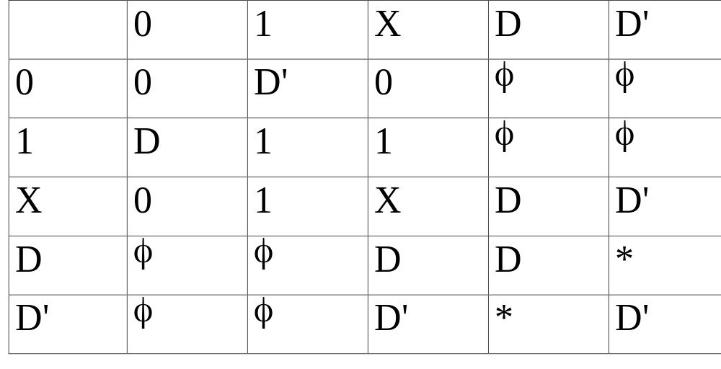
D-Intersection

Slide 33
Primitive D-Cube of Fault (pdcf)
For generating a s-a-0 fault at node c, choose a SC row which gives an o/p of 1 for the nor gate and intersect with (X,X,0).
pdcf is (0, 0, D)
a
c
b

Slide 34
PDCF (contd.)
For generating a s-a-1 fault at node c, choose a SC row which gives an o/p of 0 for the nor gate and intersect with (X,X,1).
pdcf is (1, X, D) or (X, 1, D)
a
c
b

Slide 35
Propagation D-Cube (pdc)
PDC consists of a table for each circuit element which has entries for propagating faults on any one of its inputs to the output.
To generate PDC entry corresponding to any one column, D-intersect any two rows of SC which have opposite values (0 and 1) in that column.
There can be multiple rows for one column

Slide 36
PDC Example
PDC of a AND gate with a and b as inputs and c as output
a b c
1 D D
D 1 D

Slide 37
PDC Example (contd.)
PDC of a NOR gate with a and b as inputs and c as output
a b c
0 D D’
D 0 D’

Slide 38
D-Algorithm Steps
Choose a stuck-at-fault at any of the nodes.
Choose a pdcf for generating the fault.
Choose an output and a path to the output and propagate the fault to the output by choosing pdc for all circuit elements on the path. (D-Drive)
Use the SC of all unassigned circuit elements to arrive at a consistent set of inputs. (back-propagate or consistency check)

Slide 39
D-Algorithm: PDCF Example
a
i
4
b
f
c
1
h
3
d
g
e
2
Choose a fault say g s-a-0. Choose pdcf of
gate 2 for generating this fault
(a b c d e f g h i ) = (X X X 0 0 X D X X)

Slide 40
D-Algorithm: D-Drive Example
Propagate the fault to the o/p using pdc of gates 3 &4
a
i
4
b
f
c
1
h
3
0
D
d
g
pdc 3 (X X X 0 0 1 D D’ X)
pdc 4 (0 X X 0 0 1 D D’ D’)
e
0
2

Slide 41
D-Algorithm: Consistency Example
Perform consistency operation for gate 1
a
i
4
b
f
c
1
h
3
0
D
d
g
(X X X 0 0 1 D D’ X)
sc 1 (0 1 1 0 0 1 D D’ D’)
e
0
2

Slide 42
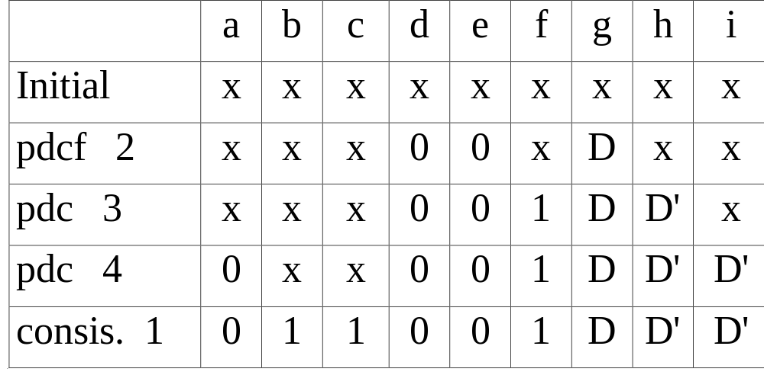
D-Algorithm: Summary

Slide 43
Testing of Sequential Circuits
M. Balakrishnan
Dept. of Comp. Sci. & Engg.
I.I.T. Delhi

Slide 44
Testing Techniques
State table verification
Random testing
Transition count testing
Scan based testing
Signature analysis

Slide 45
State Table Verification
Verify each transition by first taking the machine to a specific initial state, applying the input to perform the transition and then verifying the final state.
For this purpose we need a homing sequence and distinguishing sequence

Slide 46
Homing & Distinguishing Sequence
Homing sequence: An input is said to be a homing sequence for a m/c if the m/c’s response to the sequence is always sufficient to determine uniquely its final state.
Distinguishing sequence: An input sequence which when applied to a machine will produce a different output sequence for each choice of initial state.

Slide 47
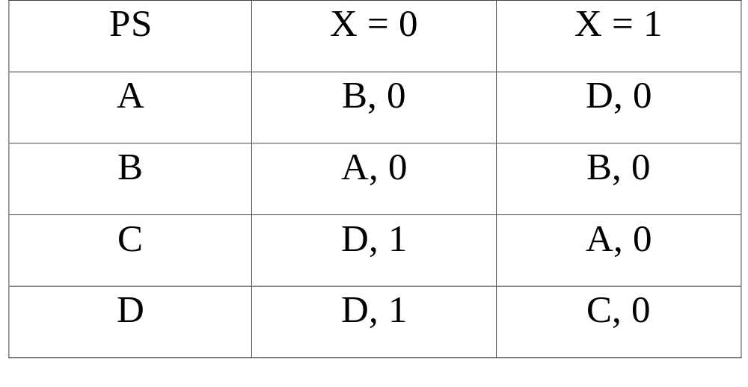
Example

Slide 48
Example: Homing Sequence
(ABCD)
0
1
(AB)(D)
(ABCD)
0
1
(AB)(D)
(BD)(C)
0
1
(A)(D)(D)
(BC)(A)

Slide 49
Random Testing
Circuit
under test
Random
pattern
generator
Compare
Known
good ckt

Slide 50
Transition Count Testing
Count the number of transitions for a specific input pattern and compare with the value stored for “good” circuits
Reduction in data storage for storing correct responses
“Aliasing” errors

Slide 51
Scan Based Testing
Form a scan chain for all the storage elements (“flip-flops”) in the circuit
Use this scan chain for inserting the test patterns as well as reading the results
Use combinational circuit test pattern generator methods generating test inputs

Slide 52
Scan Based Testing (contd.)
R
e
g
R
e
g
R
e
g
logic
logic

Slide 53
Signature Analysis & Built-in-self-test (BIST)
M. Balakrishnan
Dept. of Comp. Sci. & Engg.
I.I.T. Delhi

Slide 54
Signature Analysis
Test results available in a very compact form and thus very suitable for BIST
In-speed testing possible
PRBS generators use for test pattern generation as well as test result generation

Slide 55
PRBS Generator
A PRBS or pseudo random binary sequence generator consists of a long shift register with serial input generated by taking exclusive-or of some of the intermediate inputs

Slide 56
BIST Example
R
1
R
2
R
3
logic
L2
logic
L1

Slide 57
BIST Registers Modes
Normal mode (PIPO)
PRBS generator mode
Signature capture mode
Scan mode

Slide 58
BIST Steps: Example
R1 : PRBS mode, R2: Signature mode
Generate finite number of test patterns
R1, R2, R3: Scan mode
Scan out the signature of L1 and compare
R2 : PRBS mode, R3: Signature mode
Generate finite number of test patterns
R1, R2, R3: Scan mode
Scan out the signature of L2 and compare

